Slide 1

Weekly Report
DAW Project

Slide 2
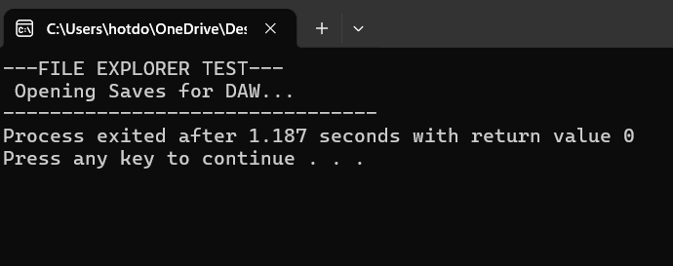

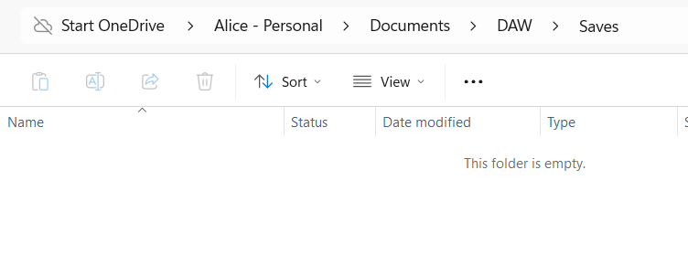
File manager update
DAW Project Report

Slide 3
Demonstration of current wxWidgets progress
DAW Project Report

